Slide 1

DSA PROJECT
Chatbot
Presentation by: Aman,Ajay,Aditya

Slide 2
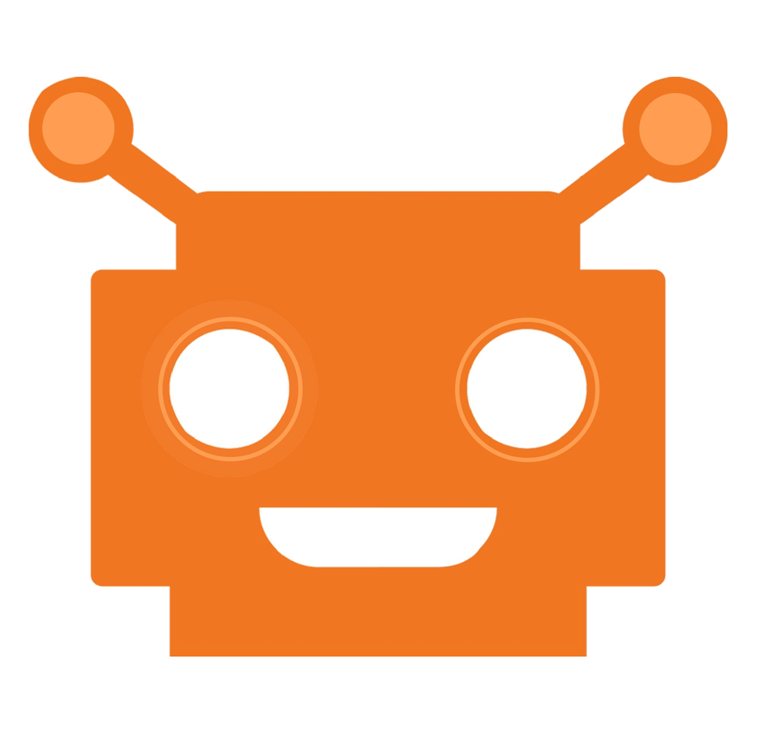
What is a Chatbot?
A chatbot is a computer program governed by a set of pre-defined rules or artificial intelligence that grants it the capabilities to communicate with and like a human.
A set of commands is fed into the system that makes it smart enough to interpret and react to user-inputted queries.

Slide 3
History of Chatbots
The idea of a bot came to light back in 1950 when Alan Turing's article about artificial intelligence was published, called as- “Computing Machinery and Intelligence”.
ELIZA (1966) and PARRY (1972) were the first two chatbots that were intended to understand and simulate human language.
Since then the industry has grown bigger and better especially with the emergence of messenger bots that integrate with platforms like Facebook, WhatsApp, Telegram, WeChat and alike.

Slide 4
Types of Chatbots
There are two types of chatbots:
#1. Based on a set of rules-
Can be referred to as a pre-programmed bot with limited capabilities. Responds to a specific set of commands and fails to do so if the inputted query does not match the database.
#2. Based on machine learning-
It has an artificial brain that’s powered by AI (Artificial Intelligence). It not just understands commands but a complete language. It learns continually with the conversations of past that eventually makes it smarter and better.

Slide 5








Some of The Chatbots Prominent Today Include The Following:
Types of Chatbots
Weather bot
Life advice bot
Grocery bot
Ticket booking bot
Financial advice bot
News bot
Scheduling bot
And the list goes on

Slide 6
How Does Chatbot Work?
A chatbot powered by AI or the one which relies on Natural Language Processing (NLP) combines several steps of code to transform text or speech into structured data, which is then used to generate a relevant response.
This is what happens:
Tokenization- A chatbot bisects the string of words into tokens.
Identification of the entity- Identifies and classifies the words, like a product’s name, a person’s name or an address.

Slide 7
How Does Chatbot Work?
Normalization- Searches for common errors like spelling or typographical mistakes.
Speech identification- Recognizes and understands parts of speech and sentence structures.
Dependency parsing- Recognizes subject, object and dependent phrases in a sentence.
Sentiment analysis- Analyzes the quality of the conversation in regard to a real human.

Slide 8
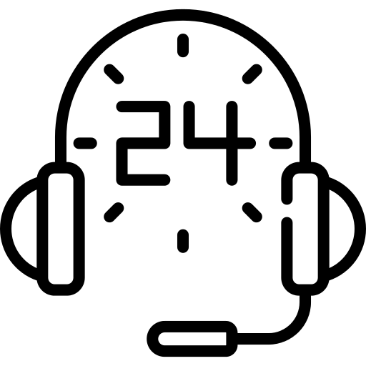
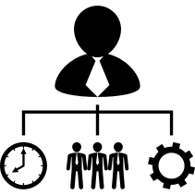




Benefits of Chatbots
With endless possibilities, chatbots can transform the thinkable into a reality. From assisting users in buying shoes to scheduling a meeting, everything can be handled with ease.
24x7 instant customer support
Helps in generating leads by answering queries in real time
Multiple platform support
(like Facebook, WeChat, Skype, Telegram and more)
Performs multiple tasks with supreme accuracy and efficiency

Slide 9
The Number Story
Chatbots have gained traction in the recent times. According to a survey by LivePerson, which incorporated over 5,000 consumers from six countries have the following to state,
38% have positive perception about chatbots
67% have used a chatbot for customer support
European countries were receptive towards chatbots
France tops the list in perceiving chatbots positively (around 50% of surveyed consumers)
Japan and the US were least receptive (only 33% & 32% respectively)

Slide 10
Technology Behind
Chatbots operate either through APIs or learn to respond like humans via machine learning.
TUI (Textual User Interface)- Bots recognize the text commands and respond to users’ requests accordingly
Machine Learning- Bots are smarter with the ability to learn patterns of natural language, interpret data of the past and respond as intended

Slide 11
Platforms To Build Your Own Chatbot

Slide 12
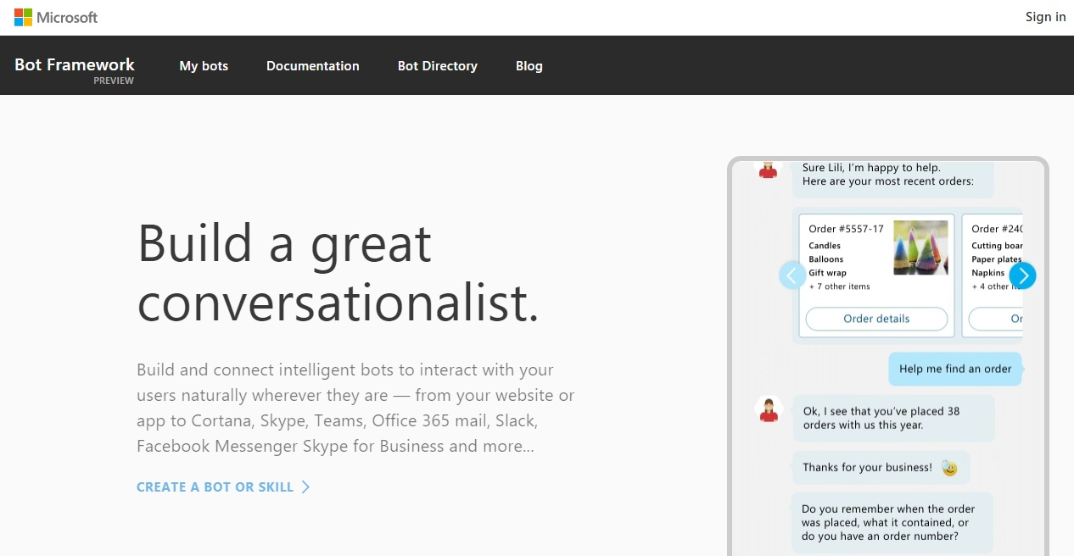
#1 Microsoft's Bot Platform
Build, test and publish your own bots, using frameworks like Express and Restify.

Slide 13
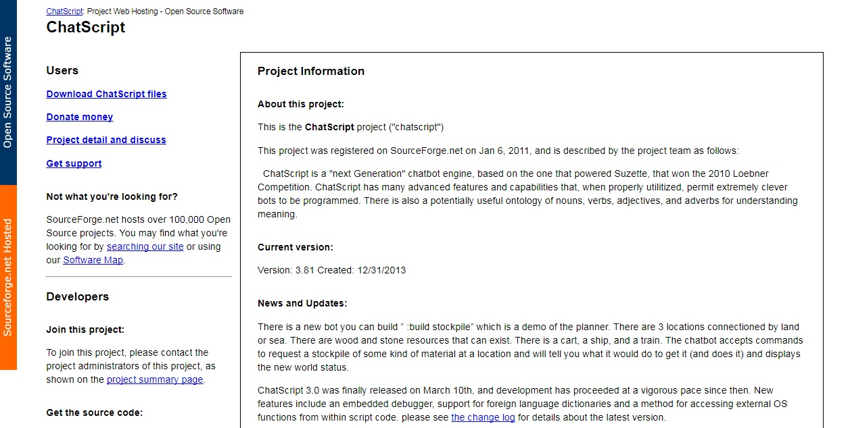
#2 Chatscript
Four times Loebner Prize winner, it’s open source and easy to build and deploy chatbots.

Slide 14
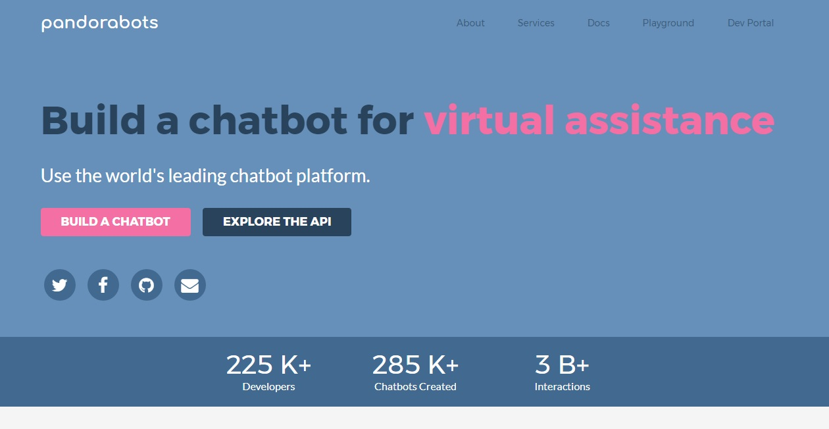
#3 Pandorabots
It uses AIML (Artificial Intelligence Markup Language) and offers an integrated development environment for chatbot development.

Slide 15
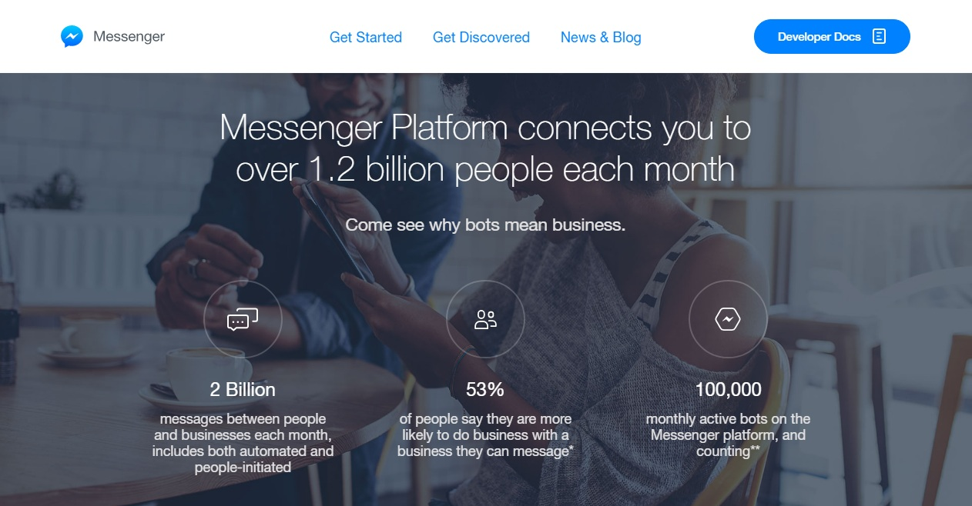
#4 Facebook’s Bots for Messenger
It helps build bots, submit them and wait for experts to approve.

Slide 16
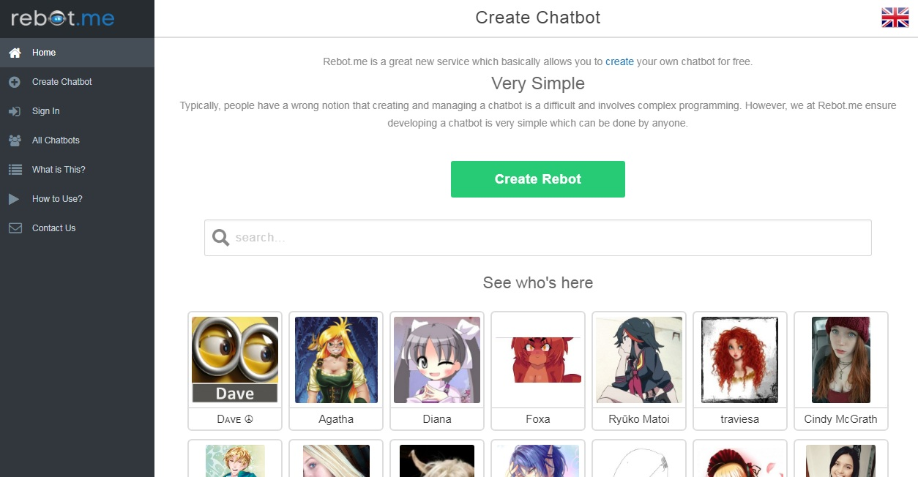
#5 Rebot.me
You don’t require programming skills to build a chatbot using Rebot.me as it learns when you interact with it.

Slide 17
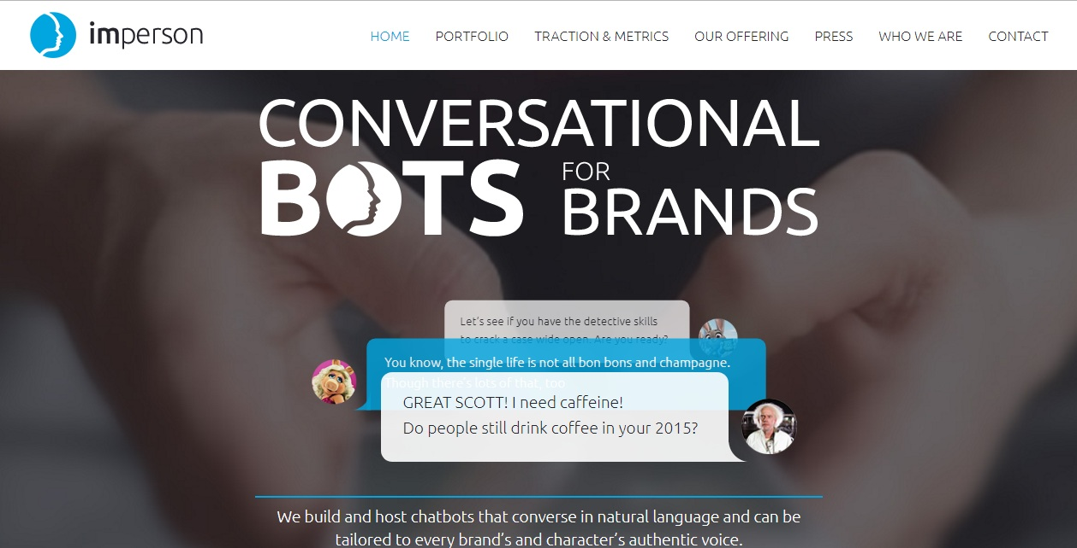
#6 Imperson
It specializes in character bots helping digital agencies to develop bots for enhanced and engaging relationships.

Slide 18








Uses of Chatbots
With an unprecedented hype lately, chatbots usage has grown significantly. Most popular uses of chatbots include:
As a ticket booking assistant
As a legal consultant
As a personal financial advisor
As a fashion stylist
As a life coach
As a food ordering partner
As a teacher
As a newsreader
And more…

Slide 19
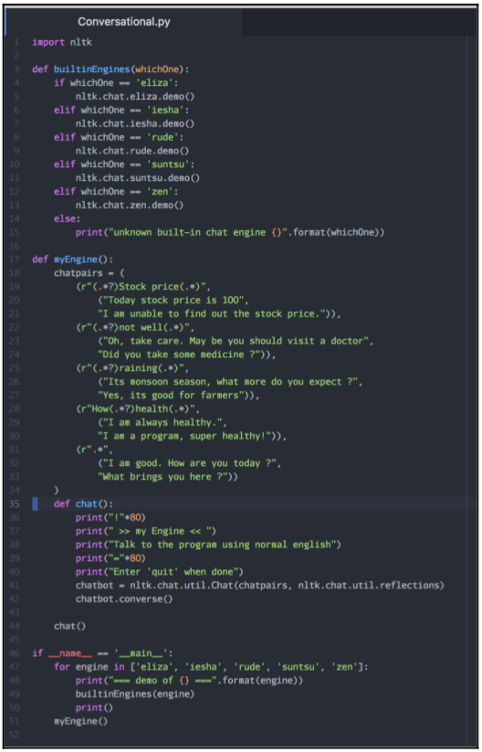
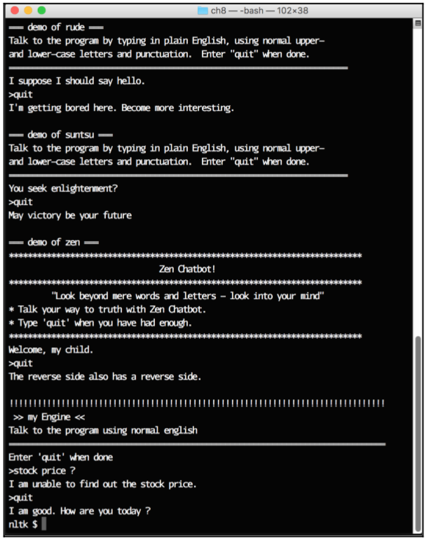
OUTPUT

Slide 20
BASIC CODE DEFINTIONS:
import nltk:
This instruction imports the nltk library into the current program.
def builtinEngines(whichOne):
This instruction defines a new function called builtinEngines that takes a string parameter, whichOne:
if whichOne == 'eliza': nltk.chat.eliza.demo()
elif whichOne == 'iesha': nltk.chat.iesha.demo()
elif whichOne == 'rude': nltk.chat.rude.demo()
elif whichOne == 'suntsu': nltk.chat.suntsu.demo()
elif whichOne == 'zen': nltk.chat.zen.demo()
else:
print("unknown built-in chat engine {}".format(whichOne))

Slide 21
Future of Chatbots
In the coming years, chatbots will rule a variety of business due to the following undeniable reasons:
Ease of creating and deploying chatbots due to comprehensive tools and platforms
An alternative to a lot of native applications which are expensive to develop
Bots can learn, become better and do tasks 24x7
Helps in enhancing user experience and support
Easy integration into messaging apps eradicates development and designing cost of UI

Slide 22




Future of Chatbots
The future of chatbots looks bright as more and more companies are investing time, money and effort to achieve their business goals via modern technologies.
Invest
Time
Money
Effort
Achieve
Business Goals

Slide 23
Refernces
1. Ayse Pinar Saygin1,Ilyas Cicekli & Varol Akman,Turing Test:50 years later,Department of Cognitive Science,University of California,San Diego;Department of Computer Engineering,Bilkent University,Bilkent, 2000
2. https://hub.packtpub.com/create-conversational-assistant-chatbot-using-python/
3. H. Chad Lane,Intelligent tutoring systems: Prospect for Guided Practice and Efficient Learning Institute for creative technologies, University of southern California, 2006
4.http://en.wikipedia.org/wiki/Chatbots

Slide 24
THANK YOU

